Slide 1
UNIT III
Technical Reading & Writing Practices
Introduction to Technical writing
Report writing
Significance of Reports
Types of Reports
Introduction to Technical Proposal writing
Types of Technical Proposals
Characteristics of Technical Proposals
Grammar-Voices & Reported Speech
Dr.Udayakumar.HM, RIT

Slide 2
INTRODUCTION TO TECHNICAL WRITING

Slide 3
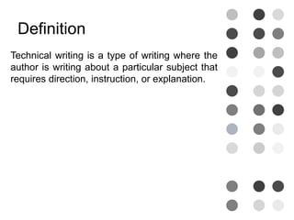

Slide 4
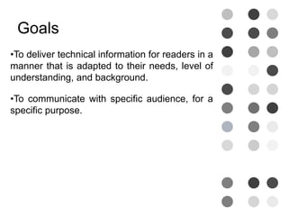

Slide 5
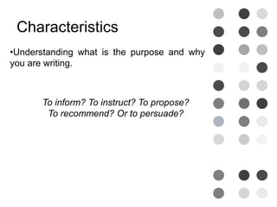

Slide 6
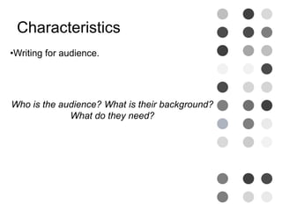

Slide 7
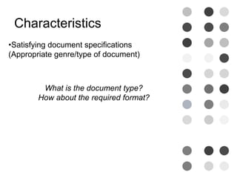

Slide 8
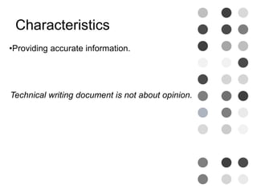

Slide 9
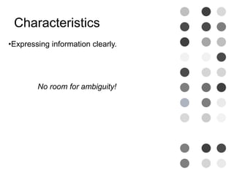

Slide 10
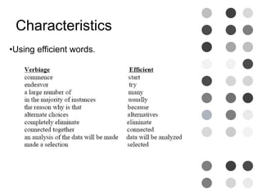

Slide 11
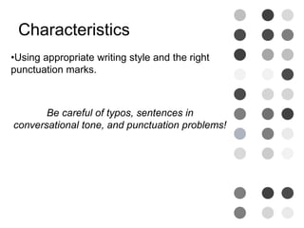

Slide 12
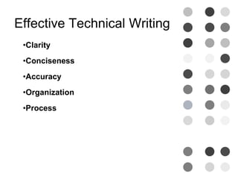

Slide 13
Report writing: Significance of Reports Types of Reports

Slide 14
REPORT WRITING
A report is a formal document written for a specific audience to meet a specific need. It may contains facts of a situation, project or process: an analysis and interpretation of data, events and records, inferences or conclusions drawn from objective data or suggestions and recommendations.
Purposes (objectives) of report waiting are:
Presenting data.
Describing and analyzing data.
Discussing and analyzing data.
Recording events and happenings.
Analyzing a situation or a condition.
Giving feedback, suggestions or recommendations.

Slide 15
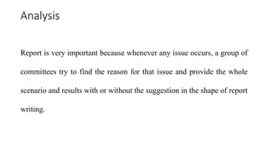
Significance of Reports

Slide 16
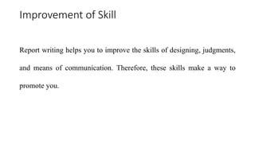

Slide 17
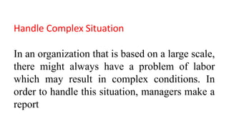

Slide 18
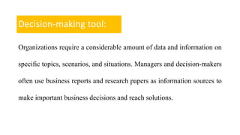

Slide 19
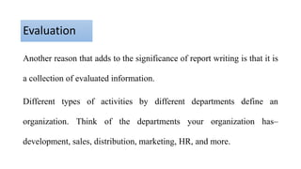

Slide 20
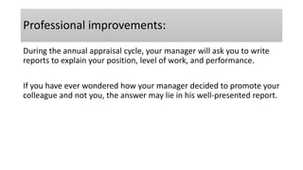

Slide 21
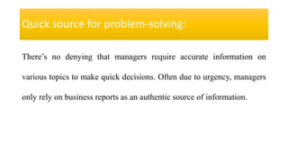
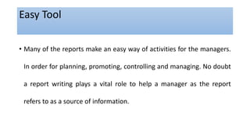

Slide 22
Characteristics of Report writing
1. Precision
2. Accuracy of Facts
3. Relevancy
4. Reader-Orientation
5. Direct Language
6. Compactness
7. Syntactic Accuracy
8. Fair Recommendation
9. Clearness
10. Appealing Presentation

Slide 23
FORMATS OF REPORT WRITING The choice of format can be made according to the nature, length, scope, and function and type of audience.
SL.NO | Format | Description
1 | Printed format | Forms prepared to record for repetitive and routine data.
2 | Letter format | Short informal reports to be communicated to someone outside an organization.
3 | Memo format | Short informal reports to be communicated to someone within an organization.
4 | Manuscript | Formal reports printed on plain paper.

Slide 24
TYPES OF REPORTS
1. Event Reports
2. Project Reports
3. Book Reports
4. Meeting Reports
5. Scientific Reports
6. Technical Reports

Slide 25
1. Event Report: As the name suggests report on an event such as College Day, Dance program, and Independence Day function or Sports event is called ‘Event Report’.
The Event Report should follow this pattern.
1. Introduction: The introduction tells the reader what the program was, it's a date, where it was held and often the names of the main participants, etc. 2. Body of the Report: Which describes the entire event in the right sequence the body of a report briefly describes every item of the event in the order in which that took place each of the items may be described who are evaluated in a sentence. 3. Conclusion: The conclusion of a report should make a final statement about an event.

Slide 26
2. Project Report: The project report is more Complex than an event report. It is a subject matter that usually has greater significance and a more detailed layout.
Parts of a Project Report
Title page
Foreword
Abstract or Summary
Contents
Introduction
Body of the Report
Conclusion
Recommendations
Bibliography
Glossary
Index
Illustrations

Slide 27
3. Book Report: A book report should have an introduction, a body and a conclusion.
Introduction: The first paragraph should introduce the whole report. It must give information about the title, the author, the year of publication, a brief description of the setting of the story.
Body of the book report: is the heart of the report. It introduces all the main characters, describes the conflict in the story and finally talks of how the conflict is resolved. This part of the report the way it is written is critical to the value of the whole report.
Conclusion: The concluding paragraph reveals the reader’s own evaluation or personal opinion of the book. It must also identify the strengths and weaknesses of the book.

Slide 28
Introduction to Technical Proposal writing: Types of Technical proposals Characteristics of Technical Proposals

Slide 29
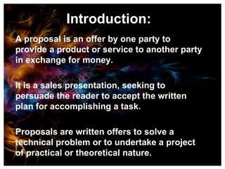

Slide 30
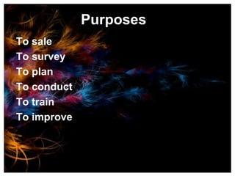

Slide 31
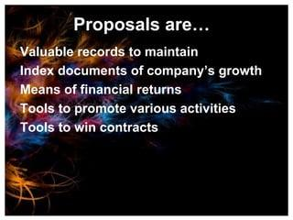

Slide 32
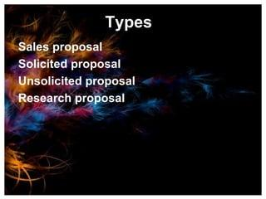
Notes:
A solicited proposal is when the customer asks for a proposal while an unsolicited proposal is when you send them a proposal they haven't even asked for. Solicited proposals are usually sent to customers who issue a “Request for Proposal” or RFP.

Slide 33
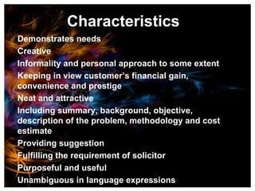

Slide 34
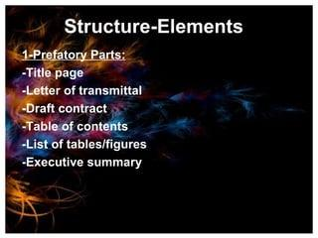

Slide 35
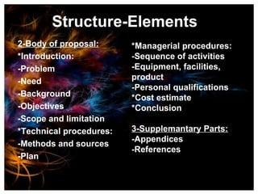

Slide 36


Slide 37
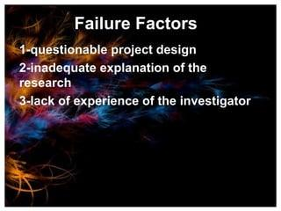

Slide 38
Grammar Voices & Reported Speech

Slide 39

Active and Passive Voice

Slide 40
Verbs and Voice
Voice is the form a verb takes to indicate whether the subject of the verb performs or receives the action.
There are two types of voice: active voice and passive voice.

Slide 41

Active Voice
Active voice is used to show that the subject of the sentence is performing or causing the action.
Example:
Lebron threw the basketball before the buzzer.
Lebron shot the basketball from the free throw line.
Lebron scored three points.

Slide 42
Passive Voice
Passive voice is used when the subject is the recipient of the action.
Example:
The ball was thrown by Lebron.
The basket was shot by Lebron.
The score was made by Lebron.

Slide 43
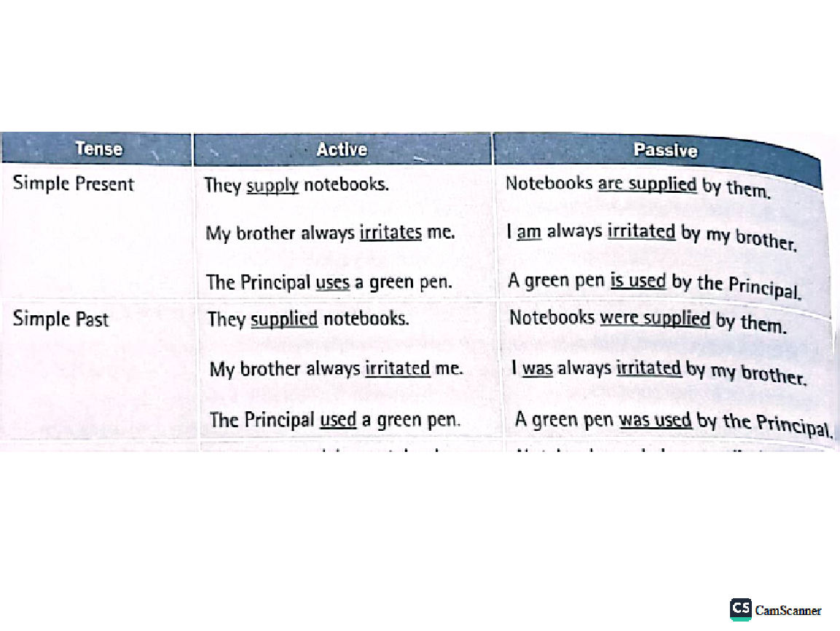
Why does it matter?
STRONG WRITING USES ACTIVE VOICE!!!!

Slide 44

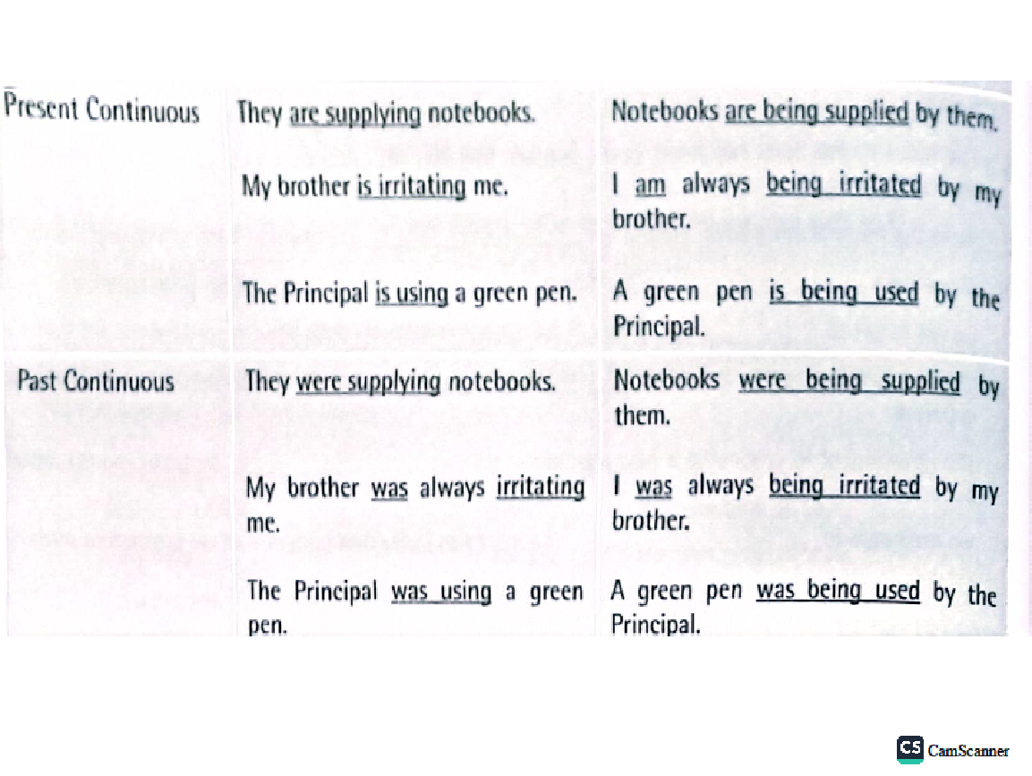
Why does it matter?
Active voice is more direct and concise.
Passive voice is usually wordier.
Active voice is like watching Lebron play.
Passive voice is like watching gum stuck on the bleachers in the stands.
MOST OF THE TIME, YOU WANT TO USE ACTIVE VOICE!!!!

Slide 45
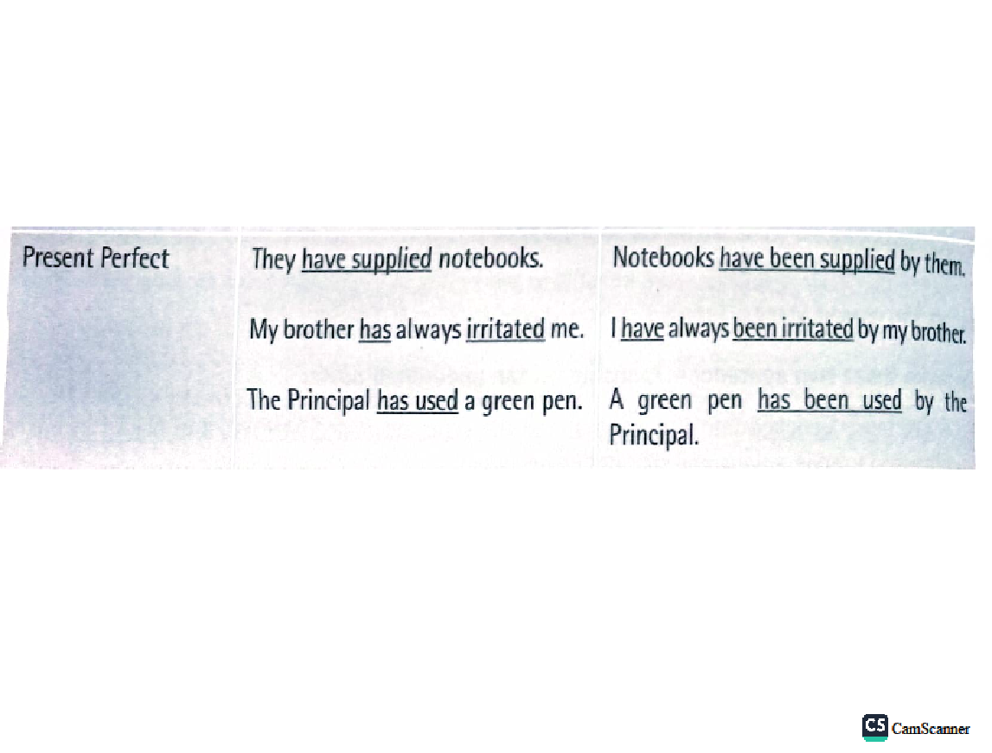
When would you WANT to use passive voice?
When intentionally trying to hide the subject of the sentence.
For example, a politician might say, “The mistake was made by someone.” Hiding the subject helps him/her hide the blame.
When intentionally trying to minimize the guilt of the subject.
For example, a cheating boyfriend might say, “Cheating was committed by me.”
When passive voice better emphasizes the main point of the message, such as “Children were harmed by the drunk driver.”

Slide 46
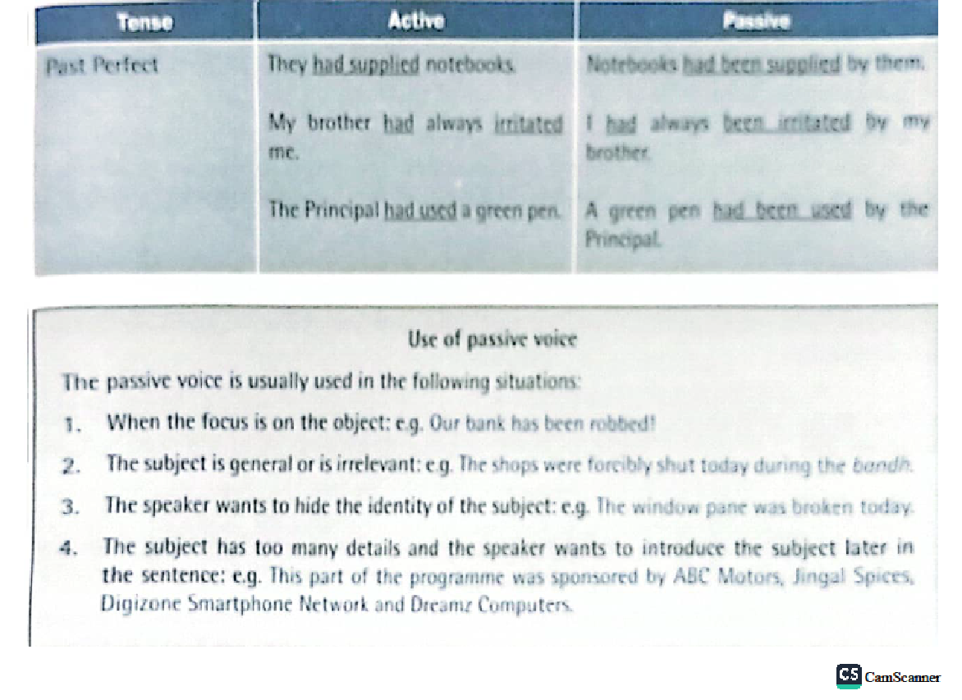
Form of Passive Voice Verbs
The passive voice requires a "double verb" and will always consist of a form of the verb "to be" and the past participle (usually the "en/ed/t" form) of another verb.
Example:
Active: John baked the bread.
Passive: The bread was baked by John. (Was is a form of the verb “be”.)

Slide 47
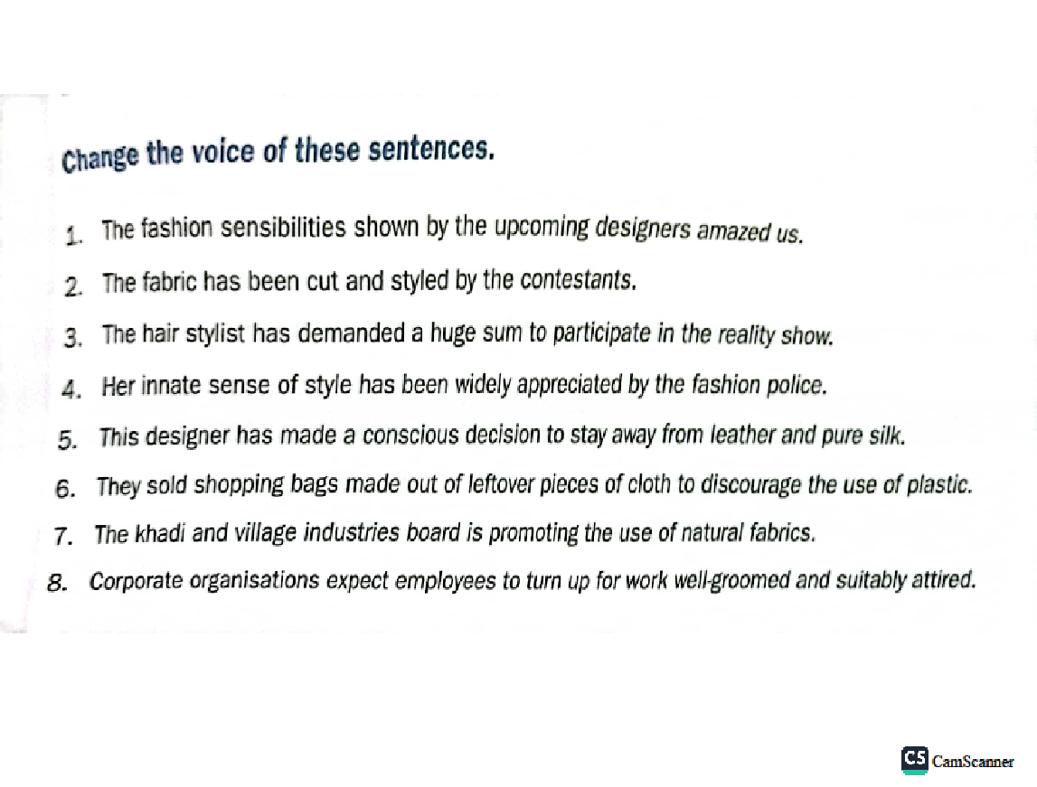
Form of Passive Voice Verbs
Writers should be familiar with the forms of "to be" , often called linking verbs, so that they can easily identify the passive voice in their work.
Review the forms of "to be":
am, is, are, was, were, be, being, been

Slide 48
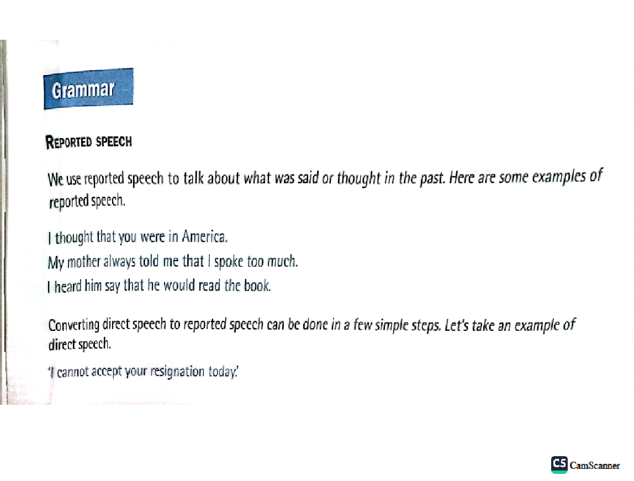
Form of Passive Voice Verbs
Note the forms of "to be" in the examples of the verb "to kick" in various forms of the passive voice:
is kicked----------------had been kicked was kicked-------------is going to be kicked is being kicked---------will be kicked has been kicked-------can be kicked was being kicked------should be kicked

Slide 49
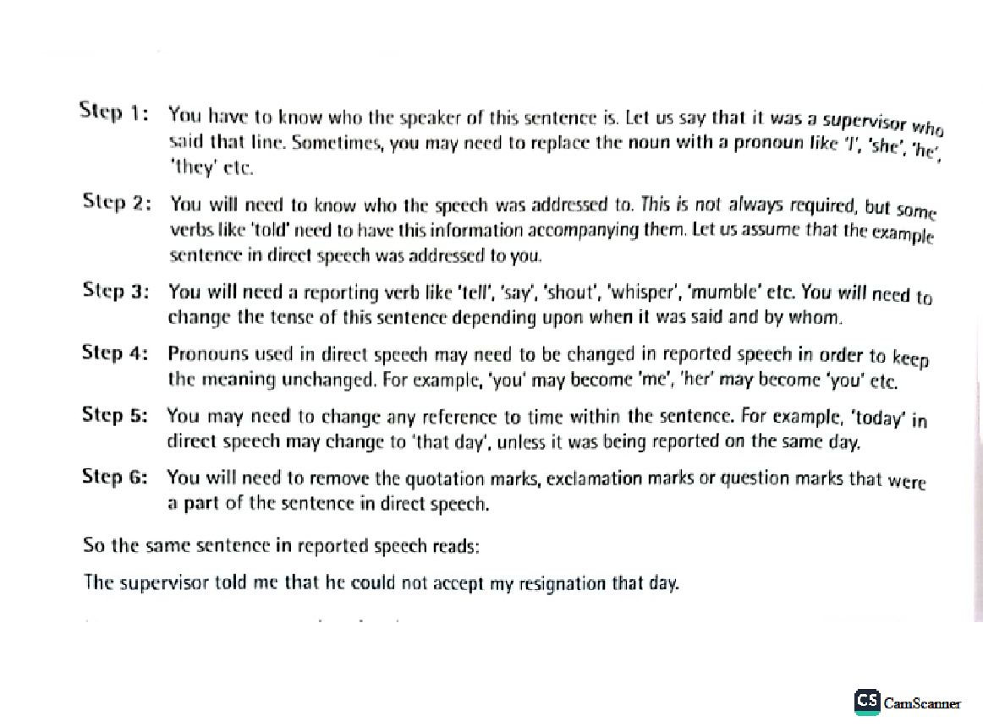
Form of Passive Voice Verbs
Examples:
Passive: The cookies were eaten by the children.
Active: The children ate the cookies.
Passive: The tunnels are dug by the gophers.
Active: The gophers dug the tunnels.

Slide 50
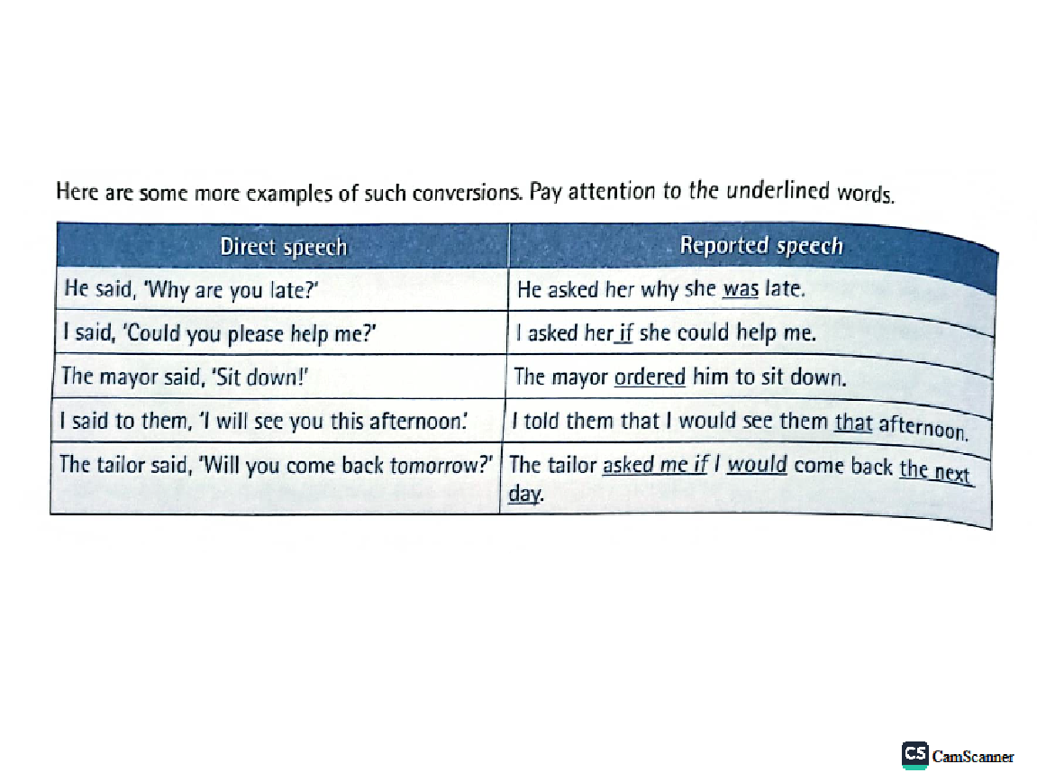
Let’s Practice
Label the following sentences ACTIVE or PASSIVE.
Louise made the chocolate cake.
The chocolate cake was made by Louise.
The package was advertised by the travel agent.
The travel agent advertised the package.
The chain was broken by my brother.
My brother broke the chain on my bike.
I hemmed the prom dress.
The prom dress was hemmed by me.
The pencil on the floor was broken by him.
He broke the pencil on the floor.

Slide 51
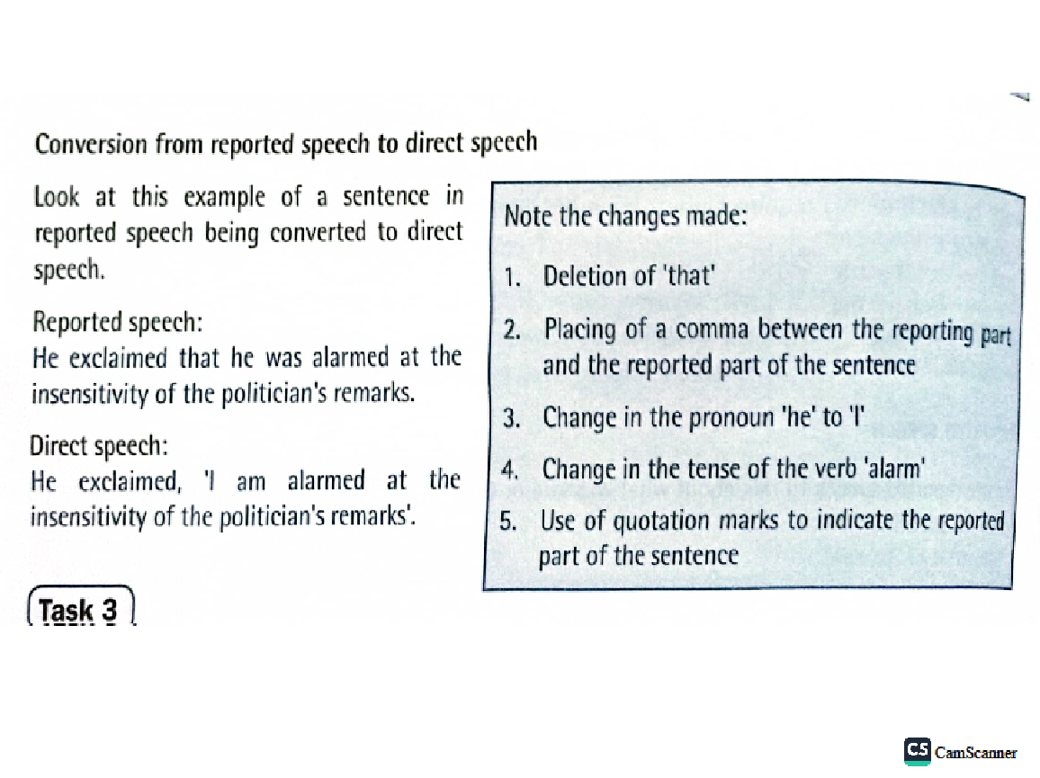
Let’s Practice
Directions: Change the sentences below to the active voice.
The statue is being visited by hundreds of tourists every year.
My books were stolen by someone yesterday.
These books had been left in the classroom by a careless student.
Coffee is raised in many parts of Hawaii by plantation workers.
The house had been broken into by someone while the owners were on vacation.

Slide 52
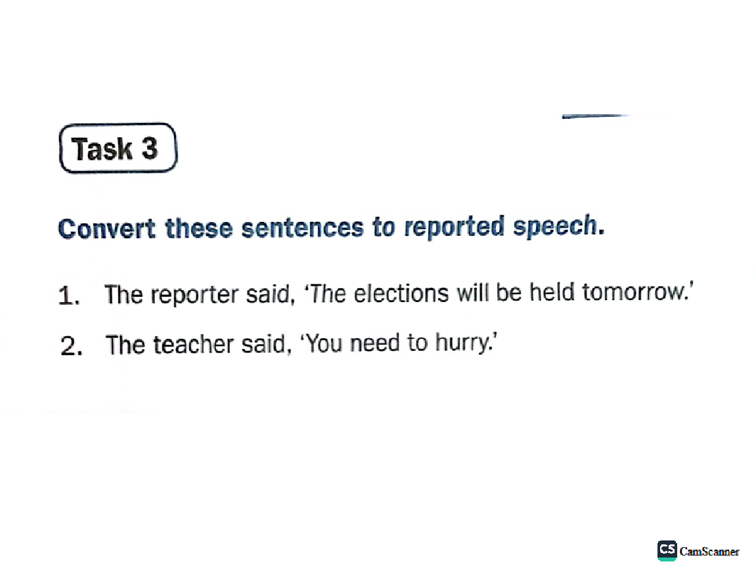
Reported Speech

Slide 53
